Slide 1
SMART HOME SYSTEM
Group name; Team-6

Slide 2
Contents
Overview
Introducing: Smart Home System
Application Domains of Smart Home Systems
Smart Home Challenges
Smart Future
References

Slide 3
Overview
Smart home technology, also often referred to as home automation or domotics (from the Latin “domus” meaning Home), provides homeowners security by allowing them to control smart devices, often by automating actions based on the homeowner’s preferences.

Slide 4
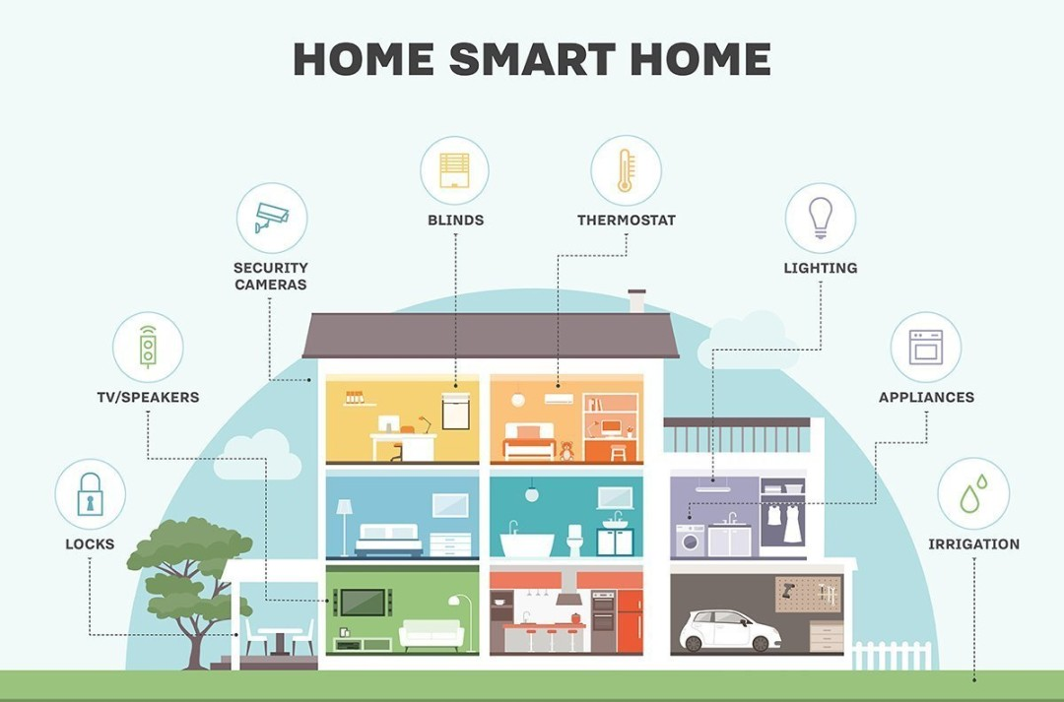
Application Domains of Smart Home System
01
Wi-Fi Connection where all the devices and controller are connected wirelessly via Internet
02
Bluetooth where all equipments are connected locally in a short range.
Z-wave where all the devices are connected wirelessly without a bride (i.e Wi-Fi router)
03

Slide 5
Smart Home Challenges
Security Smart home also comes with some security concerns.
High Cost of Intelligence: Although Smart Home have many properties that makes humans lives convenient, these smart properties are in higher price tag.
Adaptation to New Environment: owning a smart home means having to learn how to use your that requires you to adapt to many innovations.
The “Creepy” factor: There is something faintly creepy about people's houses knowing things about them.

Slide 6
The Smart Home Future
In The world of technology, the future for the smart home is definitely bright, and there are some areas where predictions can be made.
Greater Acceptance
Development
Security

Slide 7
References
[1] Jackie Craven, “What Is a Smart House?” [Online], Available: http://architecture.about.com/od/buildyourhous1/g/smarthous e.htm. [2012, October 18].
[2] Saisakul Chernbumroong, Anthony S. Atkins and Hongnian Yu, 2010, “Perception of Smart Home Technologies to Assist Elderly People”, The 4th International Conference on Software, Knowledge, Information Management and Applications (SKIMA 2010), Paro, Bhutan, pp. 1-7.
[3] Li Jiang, Da-You Liu and Bo Yang, “Smart Home Research”, 2004, Proceedings of the Third International Conference on Machine Learning and Cybernetics, August26-29, Shanghai, pp. 659-663.
[4] Manfred Huber, 2006, “Smart Home Technologies” [Online], Available: http://ranger.uta.edu/~huber/cse4392_SmartHome [2012, October 18]
[5] iT24Hrs, 2012, “Smart room, smart home” [Online], Available: http://www.it24hrs.com/2012/smart-room-smart- roomautomation. [2012, October 18].
[6] Barthold, Jim, 2005, “Changing the Way Houses Operate” [Online], Available: http://articles.castelarhost.com/smart_home_technology.htm [2012, October 18].

